Slide 1
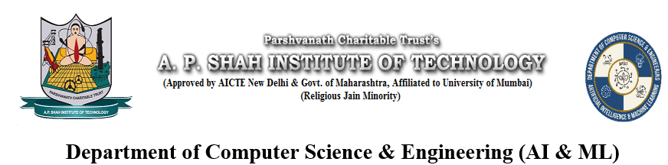
Bone Injury Detection using Machine Learning
Harsh Raulgaonkar – 23106082
Roshan Pal – 23106111
Sanidhya Pandey – 23106005
Soham Shelatkar - 23106023

Slide 2
Contents
Introduction (Global (International and National) Scenarios)
Problem Statement
Scope & Objectives
Proposed Methodology (Flowchart Representation)
Results & Analysis (if applicable)
Challenges and Solution
Conclusion or Discussion
References

Slide 3
1. Introduction
This project develops a ML-based bone injury detection system with a GUI platform for diagnosing fractures and normal cases in the elbow, shoulder, and hand.
Problem Identified:
    Human Error in Diagnosis – Small or subtle fractures may be missed in manual X-ray analysis, leading to misinterpretation and errors.
    Limited Expert Availability – Skilled radiologists are not always accessible, delaying timely fracture detection.
Solution Proposed :
    Our system aids doctors with precise fracture detection in the elbow, shoulder, and hand, reducing misdiagnosis and improving accessibility to early treatment, especially in remote and underprivileged regions.

Slide 4
2. Objectives
To develop an AI-powered system for accurate and efficient bone fracture detection.
To analyze fractures and normal cases in the elbow, shoulder, and hand using machine learning. To reduce misdiagnosis by providing a reliable decision-support system for healthcare professionals.
To create a user-friendly GUI based platform for easy access to fracture detection results.
To continuously improve the system by adding further data.

Slide 5
3. Scope
Can assist radiologists and orthopedic doctors in identifying fractures with AI-based decision support.
Can be used in remote healthcare centers where access to expert radiologists is limited.
Can be expanded to detect other skeletal injuries and abnormalities beyond fractures if more datasets are available.
Can benefit insurance companies for medical claim verification through AI-based injury assessment.

Slide 6
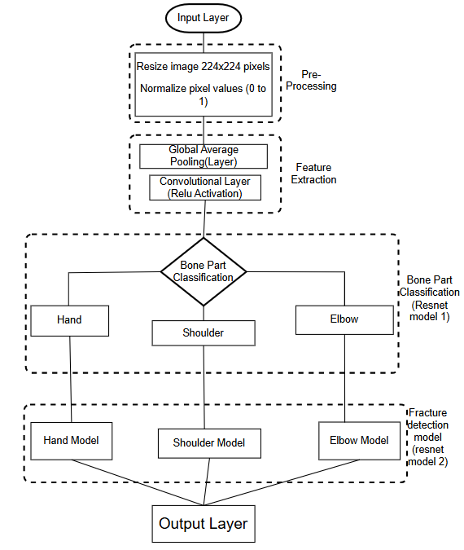
4. Proposed Methodology

Slide 7
5. Results
Model Accuracy( Small Dataset) : 80%
Model Accuracy(Large Dataset) : 92%
Comparison with Traditional Methods:
  Manual diagnosis is time-consuming and prone to human error
  CNN model provides faster and more accurate detection
Key Findings:
  Model performs best on high-resolution images
  Minor fractures are harder to detect due to limited dataset

Slide 8
6. Analysis
Analysis 1 : Accuracy and Performance
    The system leverages machine learning techniques to enhance the accuracy of bone fracture detection in medical images.
Analysis 2 : Accessibility and Usability
    The GUI-based platform makes fracture detection accessible in remote areas with limited radiology expertise.
  3. Analysis 3 : Computational Efficiency
    The model balances processing speed and precision, ensuring real-time predictions without excessive computational demands

Slide 9
7. Challenges
Dataset Limitations:
Labeled fracture datasets are scarce, making training difficult.
Collecting diverse X-ray images with different fracture types requires collaboration with hospitals.
Variations in X-rays:
X-ray images differ in contrast, brightness, and angle, affecting the model's ability to generalize.
Fractures can appear subtle or hidden depending on the imaging technique.
Imbalanced Data:
The dataset has more normal images than fractured ones, leading the model to favor the majority class.
Requires data augmentation or synthetic data generation to balance classes.

Slide 10
8. Solution
Data Augmentation:
Applied image transformations like rotation, flipping, zooming, and brightness adjustments which help model learn fracture patterns from different perspectives and reduces risk of overfitting.
Transfer Learning:
Used ResNet50 pre-trained on ImageNet instead of training a CNN from scratch.
Allows the model to leverage previously learned features like edges and textures.
Normalization & Preprocessing:
Standardized all images by resizing (224x224 pixels), normalizing pixel values (0-1), noise reduction and ensures consistent inputs.
Future possibilities:
Augmenting images using GANs (Generative Adversarial Networks) to simulate realistic fractures.

Slide 11
9. Conclusion/Discussion
This work presents a computer-based technique for bone fracture detection using X-ray/CT images, starting with noise removal, edge detection via the Sobel method, and fracture area calculation after segmentation.
The method was tested on a set of images, achieving an accuracy of around 80% for the smaller dataset and an approximate accuracy of 92% for the bigger dataset. While the results are satisfactory, it faces challenges in detecting fractures in some X-ray images. Future work aims to fully implement the method for classifying fracture types and their location

Slide 12
10. References
https://medium.com/@amanatulla1606/vanishing-gradient-problem-in-deep-learning-understanding-intuition-and-solutions-da90ef4ecb54
https://www.geeksforgeeks.org/convolutional-neural-network-cnn-in-machine-learning/
https://journalofbigdata.springeropen.com/articles/10.1186/s40537-021-00444-8
https://www.geeksforgeeks.org/residual-networks-resnet-deep-learning/
https://wisdomml.in/understanding-resnet-50-in-depth-architecture-skip-connections-and-advantages-over-other-networks/
https://www.geeksforgeeks.org/vanishing-and-exploding-gradients-problems-in-deep-learning/

Slide 13
Thank You...!!

